Slide 1
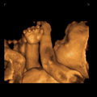
L23
Ultrasound To measure motion
The Doppler technique

Slide 2
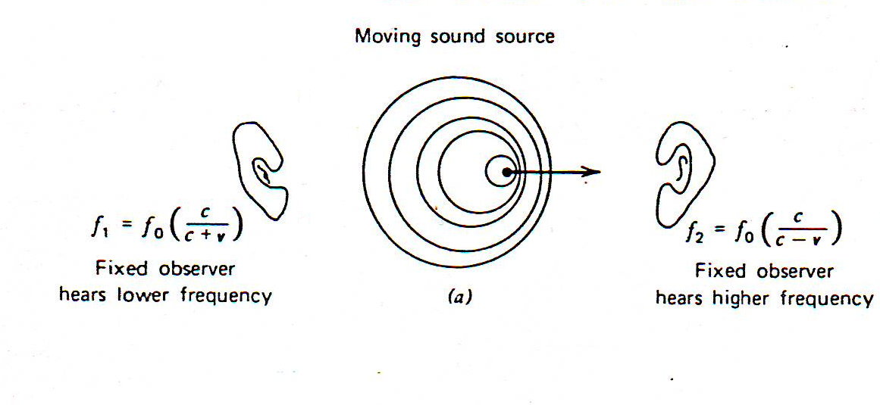
The Doppler technique
Which is used to measure blood flow.
Apparent change in received frequency due to a relative motion between a sound source and sound receiver
If a source of sound of frequency fₒ moves towards the listener, the waves begin to catch up with each other.
The wavelength gets shorter and so the frequency gets higher – the sound has a higher pitch.
And a lower pitch when it is moving away from him.

Slide 3
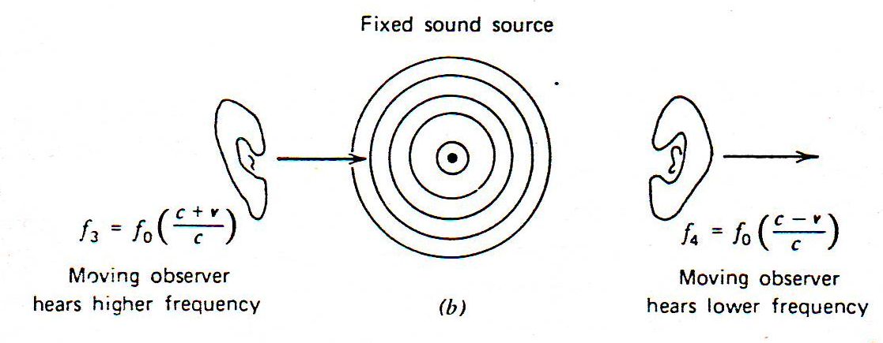
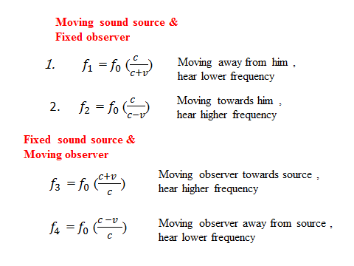
It also has a higher pitch when the listener is moving toward the source than when he is moving away from it.

Slide 4
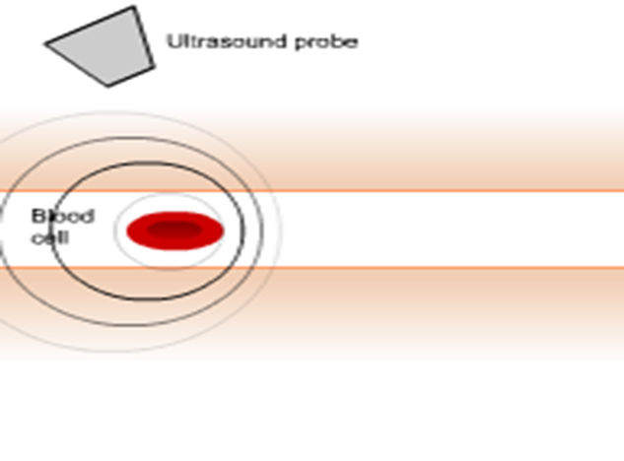
The frequency change is called the Doppler shift
We use this principle to work out how fast blood cells move.
Ultrasound reflects off the blood cells and causes a Doppler shift.
Important to note that the effect does not result because of an actual change in the frequency of the source.
An example is the speed of blood in an artery, which does not exceed about 0.4 m/s even in the aorta.
cells then act as moving wave sources
artery

Slide 5
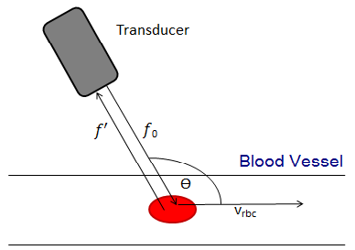
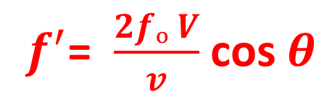

Doppler effect: change in wavelength with speed
When the blood is moving at an angle $θ$from the direction of the sound waves , the frequency change $f^{′}$ is
Where $fₒ$ is the frequency of the initial ultrasonic wave.
V is the velocity of the blood $v$is the velocity of sound
$θ$ is the angle between V and $v$
$f^{′}$= $\frac{2fₒ V}{v}$ cos $θ$

Slide 6
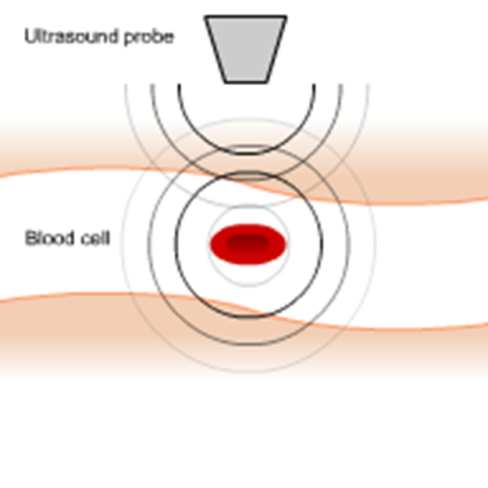
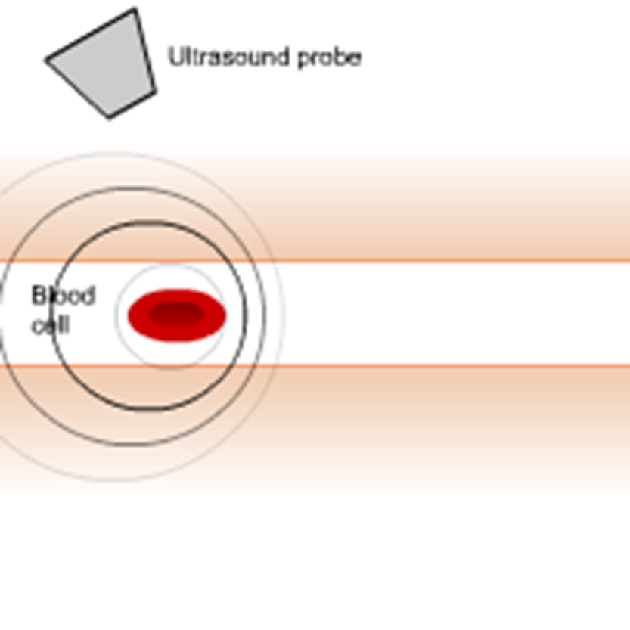
The ultrasound probe emits an ultrasound wave
A stationary blood cell reflects the incoming wave with the same wavelength: there is no Doppler shift
2. A blood cell moving away from the probe reflects the incoming wave with a longer wavelength

Slide 7
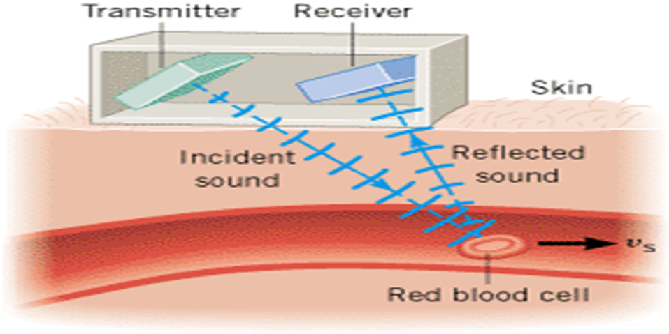
In reality, there is actually two Doppler shifts:-
The first one occurs between the probe and the moving blood cell (not shown here)
The second one occurs as the red blood cell reflects the ultrasound.

Slide 8
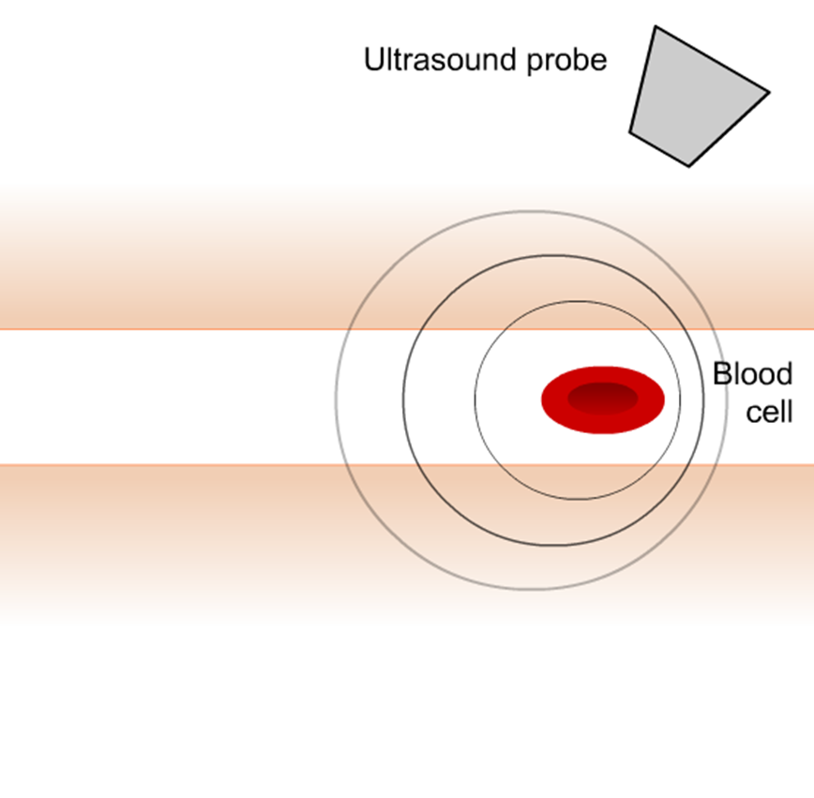
3. Now, the blood cell moves towards the probe.
It reflects the incoming wave with a shorter wavelength
Doppler effect: blood flow in artery
The Doppler flow meter is a particularly interesting medical application of the Doppler effect.
This device measures the speed of blood flow, using transmitting and receiving elements that are placed directly on the skin.

Slide 9
Doppler imaging: combine imaging and Doppler
Use both normal ultrasound imaging and Doppler imaging.
Used to image blood flow.
From the change in frequency the speed of the blood flow can be determined
Typically, the change in frequency is around 600 Hz for flow speeds of about 0.1 m/s.
The Doppler flow meter
Can be used to locate regions where blood vessels have narrowed, since greater flow speeds occur in the narrowed regions, according to the equation of continuity .
The Doppler flow meter can be used to detect the motion of a fetal heart as early as 8–10 weeks after conception.

Slide 10
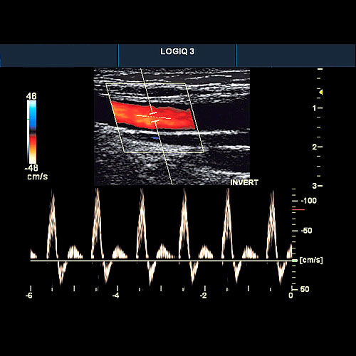
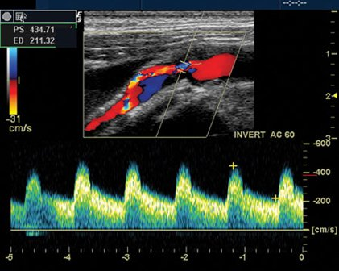
Ultrasound imaging: carotid artery
Doppler imaging looks at artery
Get image and trace of blood flow
A healthy artery. The flow is smooth and all in the same direction, like water in a large, slow river
A carotid artery.
The flow is not all in the same direction. It is turbulent, like rapids in a river.
This is usually due to a build-up of fatty deposits in the artery

Slide 11
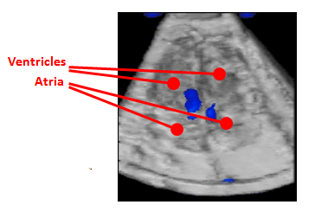
Ultrasound imaging: 4D Doppler ultrasound
This is a complicated image of the heart of a foetus. It shows the blood moving between the ventricles and the arteries.

Slide 12
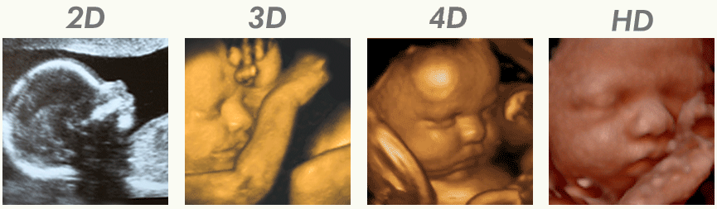
Ultrasound: safety
Ultrasound is energy and is absorbed by tissue, causing heating
2D ultrasound has been used to image the foetus for about 50 years.
It is thought to be completely safe and does not cause significant heating
4D ultrasound is new, requires more energy and therefore generates more heating. We think it is safe.
Should we use it to diagnose foetal illness?
Should we use it to make videos of healthy babies for parents?

Slide 13
The physiological effects of ultrasound
Ultrasound may induce thermal and non‐thermal physical effects in tissues .
Non‐thermal effects can be achieved with or without thermal effects.
Thermal effects of ultrasound upon tissue may include
Increased blood flow,
Reduction in muscle spasm,
Increased extensibility of collagen fibers and a pro‐inflammatory response.
It is estimated that thermal effects occur with elevation of tissue temperature to 40–45°C for at least 5 min .
Excessive thermal effects, seen in particular with higher ultrasound intensities, may damage the tissue

Slide 14
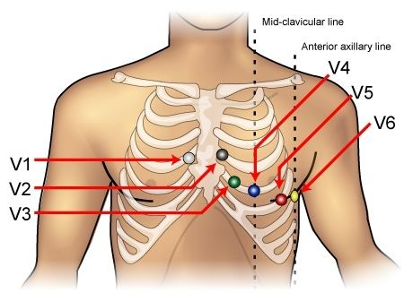
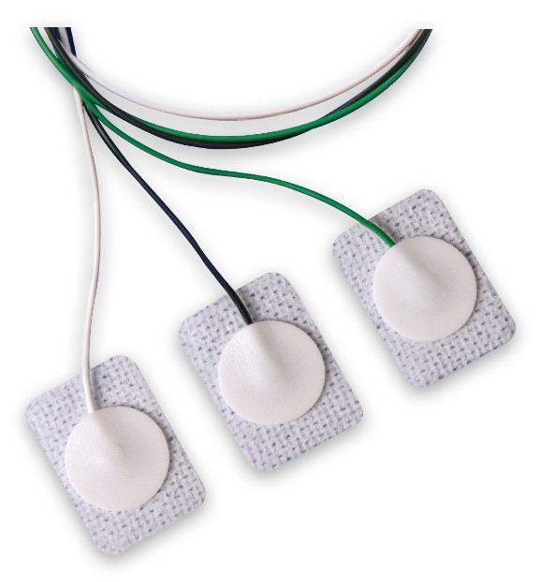
L28
The Electrocardiogram(ECG)
ECG Basics
Electrocardiography (ECG) is the process of recording the electrical activity of the heart over a period of time using electrodes placed on the skin.
These electrodes detect the tiny electrical changes on the skin that arise from the heart muscle's electrophysiology pattern of depolarizing during each heartbeat.

Slide 15
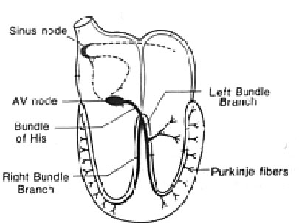
Normal Impulse Conduction
Sinoatrial node
AV node
Bundle of His
Bundle Branches
Purkinje fibers

Slide 16
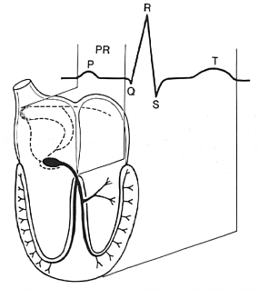
Impulse Conduction & the ECG
Sinoatrial node
AV node
Bundle of His
Bundle Branches
Purkinje fibers

Slide 17
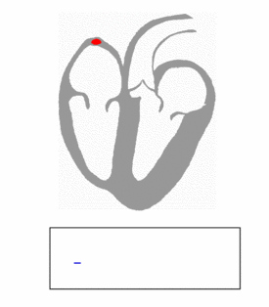
The “PQRST”
P wave - Atrial depolarization
QRS - Ventricular depolarization
T wave - Ventricular repolarization

Slide 18
The PR Interval
Atrial depolarization
+
delay in AV junction
(AV node/Bundle of His)
(delay allows time for the atria to contract before the ventricles contract)

Slide 19
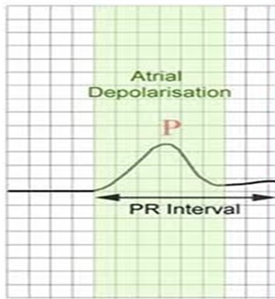
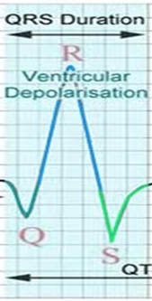
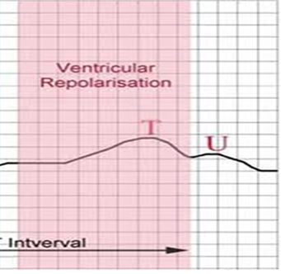
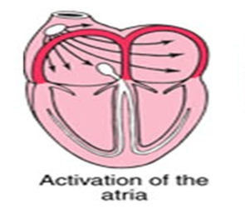
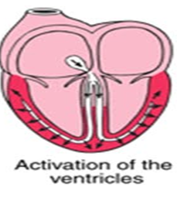
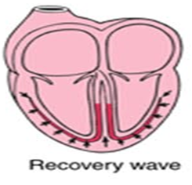
What an ECG traces looks like recovery wave

Slide 20
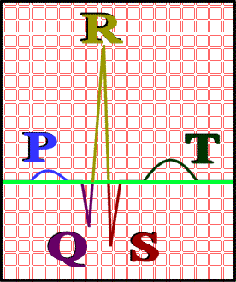
P wave: atrial depolarization
QRS complex: (<120ms)(0.12sec)
◘ Q wave: first downward (negative) deflection (not always present) ~ septal depolarization
◘ R wave: upward (positive) deflection
◘ S wave: downward (negative) deflection following an R wave
T wave: ventricular repolarization
(a positive deflection, since repolarization is in opposite direction)
PR interval: (120-200ms) (0.12-0.20 sec)time between beginning of P wave and beginning of QRS complex

Slide 21
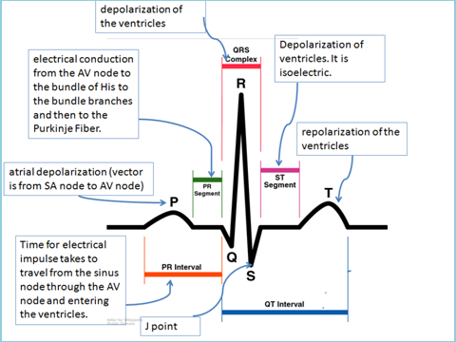
ST segment: time between QRS complex and start of T wave (plateau phase of cardiac muscle)
QT interval: ~400ms - time between beginning of QRS complex and end of T wave

Slide 22
The ECG Paper
An ECG is printed on paper covered with a grid of squares.
The baseline: it is the line that would be perfectly straight and horizontal if not for those vertical deflections. This is called the isoelectric line

Slide 23
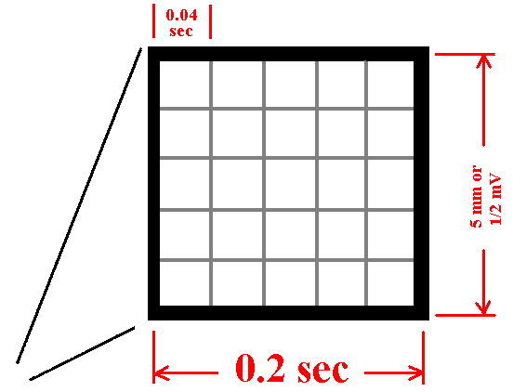
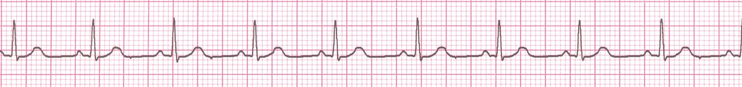
The ECG Paper
Horizontally
  One small box - 0.04 s
  One large box - 0.20 s
Vertically
  One small box – 0.1mV
  One large box - 0.5 mV
Notice that five small squares on the paper form a larger square.
The width of a single small square on ECG paper represents 0.04 seconds.
To successfully interpret ECGs, you must have this value committed to memory.

Slide 24
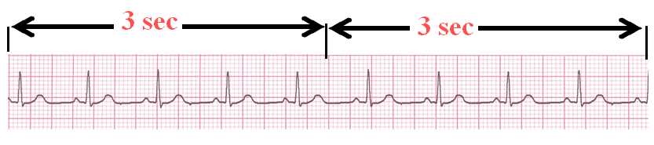
Rhythm Analysis
ECG Rhythm calculation and Interpretation
Step 1: Calculate rate.
Step 2: Determine regularity.
Step 3: Assess the P waves.
Step 4: Determine PR interval.
Step 5: Determine QRS duration.
The ECG Paper (count)
Every 3 seconds (15 large boxes) is marked by a vertical line.
This helps when calculating the heart rate.
NOTE: the following strips are not marked but all are 6 seconds long.

Slide 25
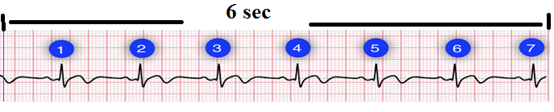
Step 1: Calculate Rate
Option 1
3 sec
3 sec
Count the number of QRS complexes over a 6 second interval.
Multiply by 10 to determine heart rate. (since 6 seconds times 10 is 60 seconds or 1 minute).
Interpretation?
9 x 10 = 90 bpm
This method works well for both regular and irregular rhythms.
In this image, we can count 7 QRS complexes, so the heart rate is 70.

Slide 26
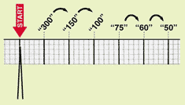
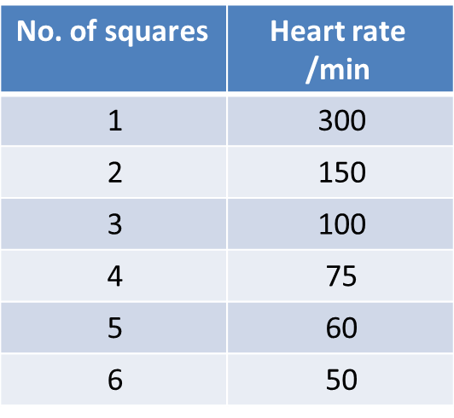
Step 1: Calculate Rate
Option 2
R wave
  Find a R wave that lands on a bold line.
  Count the no. of large boxes to the next R wave.
  If the second R wave is 1 large box away the rate is 300, 2 boxes - 150, 3 boxes - 100, 4 boxes - 75, etc. (count)

Slide 27
Step 1: Calculate Rate
100
75
60
50
300
150
  Memorize the sequence:
  300 - 150 - 100 - 75 - 60 - 50
Interpretation?
  Approx. 1 box less than 100 = 95 bpm

Slide 28
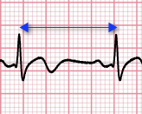
Step 1: Calculate Rate
Option 3
The 3rd method uses small boxes. Count the number of small boxes for a typical R-R interval. Divide this number into 1500 to determine heart rate.
HR=1500/(no. of small boxes between R-R interval)
In this \image, the number of small boxes for the R-R interval is 21.5. The heart rate is 1500/21.5, which is 69.8 bpm.

Slide 29
Step 2: Determine regularity
R
R
Look at the R-R distances (using a caliper or markings on a pen or paper).
Regular (are they equidistant apart)
Occasionally irregular, Regularly,
irregular Irregularly irregular?
Interpretation?
Regular

Slide 30
Step 3: Assess the P waves
Are there P waves?
Do the P waves all look alike?
Do the P waves occur at a regular rate?
Is there one P wave before each QRS?
Interpretation?
Normal P waves with 1 P wave for every QRS

Slide 31
Step 4: Determine PR interval
Normal: 0.12 - 0.20 seconds.
(3 - 5 boxes)
Interpretation?
0.12 seconds
Step 5: QRS duration
Normal: 0.04 - 0.12 seconds.
(1 - 3 boxes)
Interpretation?
0.08 seconds

Slide 32
Rhythm Summary
Rate 90-95 bpm
Regularity regular
P waves normal
PR interval 0.12 s
QRS duration 0.08 s
Interpretation?
Normal Sinus Rhythm

Slide 33
